Slide 1
Statistical models for polygenic traits
Daniel Crouch
daniel.crouch@well.ox.ac.uk
Wellcome Centre for Human Genetics, University of Oxford

Slide 2
Introduction
These sessions build on what you’ve learned about genome-wide association studies
Most GWAS implicate large numbers of SNPs in both common diseases (e.g. type II diabetes, bipolar disorder) and normally distributed phenotypes (e.g. height, BMI and IQ)
What can we do with SNP data to analyse the genetics of these complex phenotypes?
We will implement a specific model for the relationship between SNPs and phenotype, and see what inferences we can use it to make.

Slide 3
Some issues with straightforward GWAS
1) Performing 1000s of separate simple analyses and correcting P-values for multiple tests afterwards
Can control false-positives, but what about estimating effect sizes? (“Winner’s curse”)
2) Often, many SNPs will have true associations but with very small effect sizes
Significant associations of specific SNPs become less important (versus, e.g. cumulative genetic effects in a biological category)
Lack power to obtain significant associations with these specific variants of very small effect

Slide 4
Odds ratios of genome-wide significant GWAS ‘hits’ in 7 diseases originally studied by the WTCCC
…and still only a fraction of disease heritability is explained (must be many even smaller effects we can’t detect as ‘significant’)
Crouch and Bodmer
(PNAS 2020)

Slide 5
What’s the model?
In science we’re essentially trying to model things.
In statistics we’re usually calculating evidence for which ‘fit’ of a model (i.e. which parameter values) is most likely correct
The standard GWAS model is simple and makes very few assumptions. This has pros and cons

Slide 6
Example: estimating SNP effects
Suppose we want the best estimate of SNP j’s effect size, given the simple estimate we calculated in a GWAS, z_{j}. Some form of posterior expectation is really what we want:
How to work this out? Use Bayes’ Theorem and take expectation of resulting posterior distribution.

Slide 7
Example: estimating SNP effects
Usually the best model for the effect size, assuming it has been standardised (i.e. variance 1), is:
…which we use for , but what about the other two probabilities?

Slide 8
Example: estimating SNP effects
What’s a sensible model? First, we could assume that all SNPs j have effects drawn from the same prior distribution, e.g:
….which gives us , but we can only use it if we know M and A.
The marginal we can get from the other two probabilities by integration:

Slide 9
Example: estimating SNP effects
The fully Bayesian approach is to use your prior knowledge about M and A to make an informed guess.
With the empirical Bayes approach, we estimate M and A from across the full range of SNPs we have, like a frequentist, and plug the estimates in, which gives approximately
See Efron and Hastie Computational Age Statistical Inference Chapter 7

Slide 10
Example: estimating SNP effects
As goes to infinity we end up with
Therefore, using the simple estimate we got from our GWAS is equivalent to assuming that the prior variance A for the SNP effects is infinite (i.e. no prior knowledge used - frequentism)
This might be justified (e.g. for ‘stand out’ SNPs with unusually large effects), but the better estimate is usually the first one.

Slide 11
What’s the model?
We have shown how the choice of prior parameters (estimated or infinite variance) affects our conclusions about the effect of a SNP
This is a general point. There are any number of distributions and parameters one might choose, both for the prior and the likelihood

Slide 12
Practical: implement the estimator
Go https://github.com/jpwhalley/GMS_Stats_Course/tree/master/5_Statistical_Analysis_of_Genome-wide_data for dataset (zStats and MAF)
Read in zStats data using read.table(…)
Plot the GWAS estimates. Is the data normal? Use ‘hist()’.
Fit estimator
Estimate A (crudely) as sd(x)^2-1
Estimate M as mean(x).
Compare with the basic GWAS estimates. Use plot(zStats,est).
What do you think are the pros and cons of each estimate (without knowing the true underlying parameter values) ?
Convert Zs into log ORs by multiplying by the SE. Same pattern or different?

Slide 13
Other types of prior
Double exponential (laplacian)
Spike and slab
Mixed normals (see e.g. BOLT-LMM)
‘Non parametric’ approaches

Slide 14
Part 2: Improving the model
We will now look at how a similar model can be used to…
a)Work out how much trait variation is explained by the SNP data
b)Do better primary GWAS analysis (tomorrow)
c)Predict phenotype from genotype (tomorrow)
….in the presence of genetic relatedness. For this we will model individual level data as opposed to summary statistics.

Slide 15
Gene/environment model
= phenotype for individual i
= covariate k for individual i
= allele at SNP j for individual i
= effect of covariate k
= effect of SNP j
= residual
(Yang et al. American Journal of Human Genetics, 2011)

Slide 16
Gene/environment model
Can write in matrix form as:
(Yang et al. American Journal of Human Genetics, 2011)

Slide 17
Gene/environment model
There is more to decide about the model beyond this equation, e.g:
-Which variables are random are which are known constants?
-What are the probability distributions of the random variables?
Any suggestions?

Slide 18
Gene/environment model
We’ll treat X and W as known constants – transfer the randomness onto other variables like in a linear regression
y_{i} is also observed in the data, but we’ll assume it is related to everything in the summations by the random variable
Which other variables are random (assume an underlying distribution) and which are fixed (assume a fixed underlying true value)?

Slide 19
‘Fixed’ and ‘random’
Parameters can be random or fixed
Parameters are things like ‘true effect of an allele’, or ‘true average height difference between men and women’: things that control the probability of data and that we often want to infer. Can be fixed or random
Constants are non-random variables. Data we do not apply probability distributions to
Random variable typically refers to data that are assumed to be generated by an underlying distribution – includes parameters and data points

Slide 20
‘Fixed’ and ‘random’: Example depiction of a probability model
Fixed parameter
Random variables
Random parameter
Parameter probability distribution
Fixed parameter (hyper-parameter)

Slide 21
It is standard to assume that the environmental component, is normally distributed
X is constant and is a vector of fixed effects: they do not vary so they have no variance.
Assume each u_{j} is random, with same prior normal distribution as in our previous model, then the variance of y is
….and its expected value (mean) is

Slide 22
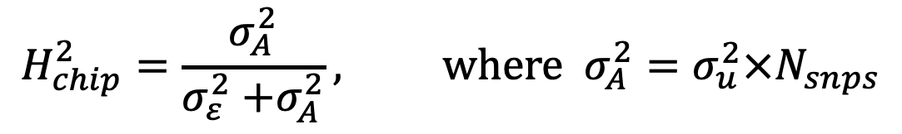
Nice properties of this model
Not too many parameters to fit ( ). Don’t have to fit an effect for each SNP, which is hard.
tells us directly the variance in y that is explained by the genetic data. The ‘Chip heritability’ is then:
…which we could for example use to find how much heritability is explained via a certain portion of genes.
$$H_{chip}^{2}=\frac{σ_{A}^{2}}{σ_{ε}^{2}{+σ}_{A}^{2}}, \text{where} σ_{A}^{2}=σ_{u}^{2}×N_{snps}$$

Slide 23
Nice properties of this model
-We’re accounting for relatedness
WW’ is known as the genetic relatedness matrix
Measures genetic covariance

Slide 24
What is this estimate of heritability?
The genetic variance we can explain using the data we have genotyped (and imputed if applicable)
This tends to much lower than the estimate of heritability we can from classical (non-molecular) genetics, usually twin studies – can you think why?
This is changing (Wainschtain et al. 2019, bioRxiv, Recovery of trait heritability from whole genome sequence data)

Slide 25
Random or Fixed? Bayesian or Frequentist?
The real parameters of interest in this use of the model are
and , and to a lesser extent
I’ve stated that we’ll assume is fixed: is this best? Why?
What about and ?

Slide 26
Random or Fixed? Bayesian or Frequentist?
I’ve stated that we’ll assume is fixed – is this best? Why?
What about and ?
We’ve seen how an empirical Bayesian analysis can work for random SNP effects (compute the posterior expectation)
For fixed parameters we use frequentist estimation, usually maximum likelihood
Answer: there is no right answer, but the one you chose depends how you wish to utilise prior information

Slide 27
Fit the model in R using maximum likelihood
Read in data using read.table(…)
Scale and center each variable, use scale(…)
Calculate genetic relatedness matrix: GRM=genoScaled%*%t(genoScaled)/N
Write a likelihood function (i.e. the multivariate normal shown before)
NegLogLikelihood<-function(x){…}
Maximise log-liklihood function using constrOptim

Slide 28
Part 3: Improving GWAS association analysis
Two parts:
a)Fit association model in presence of relatedness by using yesterday’s model (mixed-model association analysis)
b)Is there a better way than Bonferroni correction to establish significance? Yes: the False Discovery Rate

Slide 29
Back to our linear model
Second summation is over the fixed effects, in contrast with the random effects in the first
Fixed effects are good for estimating specific effects of interest
We already know how to fit this model – but how to get a P-value out of it?

Slide 30
Stratification/relatedness
Standard one-variable at a time GWAS uses a combination of PC covariates and removing individuals with relatedness below about 10% or 20%
The mixed model approach is to picture a bivariate normal distribution for the phenotypes of two individuals with correlated genotypes, but ‘expand’ to dimensions equal to the sample size:
unrelated
related
x=ind1 phenoype, y=ind2 phenotype, z=density

Slide 31
Likelihood ratio test
There are three common types of significance test
1) Wald test
2) Score test
3) Likelihood ratio test
Likelihood ratio tests are generally the best.
- Likelihood is maximised and compared to the maximised likelihood from a null model.
- Usually the null model is one in which the parameter of interest is forced to be zero
Use likelihood function
k = degrees of freedom equal to difference in number of parameters between models

Slide 32
Practical: estimate and test fixed effects for each SNP in turn
Use functions from yesterday
Fit null and alternative models
Use apply() to loop over SNPs
Implement likelihood ratio tests to get P-values. Use pchisq()
This will be slow. Can you think of a trick to speed things up?
Can you compare estimates for some SNPs with the GWAS Z stats?
Do you think we’re OK calculating the GRM using all SNPs?

Slide 33
Mixed model simplifications
Estimate variance components and
first, then fix during association testing
e.g. EMMAX (2010)
Find analytical maxima for some parameters, then maximise the likelihood for the others
e.g. GEMMA (2012) – analytical maxima for all parameters except:

Slide 34
Part 4: significance testing in ‘big data’ scenarios
Need to correct for large number of tests in order to control false positives
We can usually do better than bonferroni correction using false discovery rates
These have an empirical Bayes’ interpretation. (Chapter 15, Efron and Hastie 2017)

Slide 35
Local false-discovery rate
Observed distribution
Null distribution
Plug in observed distribution
for the marginal
Estimate or guess prior

Slide 36
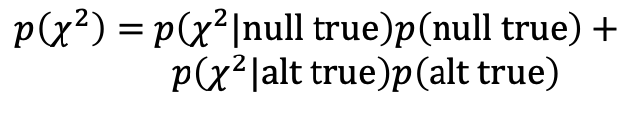
Local false-discovery rate
Observed distribution
Null distribution
The likelihood for the data, which can be used for maximum likelihood estimation of parameters like we did yesterday, is
$p\left(χ^{2}\right)=$ $p\left(χ^{2}|\text{null} \text{true}\right)p\left(\text{null} \text{true}\right)+$
$p\left(χ^{2}|\text{alt} \text{true}\right)p\left(\text{alt} \text{true}\right)$

Slide 37
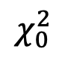

Tail area-discovery rate
$\text{FDR}\text{(}χ_{0}^{2}\text{)}=$ $p\left(\text{null} \text{true}\text{|}χ_{i}^{2}>χ_{0}^{2}\right)=\frac{p\left(χ_{i}^{2}>χ_{0}^{2}|\text{null} \text{true}\right)p(\text{null} \text{true}\text{)}}{p\left(χ_{i}^{2}>χ_{0}^{2}\right)}$
is a threshold which we can pick so that ’SNPs with chi-square values greater than the threshold have an FDR of …. X%’
These are analogous to p-values (‘Values falling in the tail area beyond alpha have an error rate equal alpha’) but remain correct when performing multiple tests at once
A similar approach is the q-value (Storey, 2002), but this is a a bit more complex
$$χ_{0}^{2}$$

Slide 38

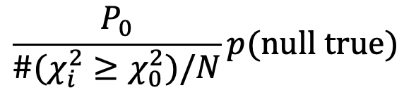
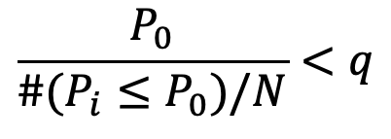
Tail area-discovery rate
$\text{FDR}\text{(}χ_{0}^{2}\text{)}=$ $p\left(\text{null} \text{true}\text{|}χ_{i}^{2}>χ_{0}^{2}\right)=\frac{p\left(χ_{i}^{2}>χ_{0}^{2}|\text{null} \text{true}\right)p(\text{null} \text{true}\text{)}}{p\left(χ_{i}^{2}>χ_{0}^{2}\right)}$
Can be estimated as…..
$$\frac{P_{0}}{\#(χ_{i}^{2}≥χ_{0}^{2})/N}p(\text{null} \text{true})$$
The strictly frequentist way of controlling FDR is called the Benjamini-Hochberg method and is closely related. This accepts SNP i as significant if it has:
where q is a chosen threshold e.g. 5%.
So here we have a close connection between empirical Bayesian and frequentist methods.
$$\frac{P_{0}}{\#(P_{i}≤P_{0})/N}<q$$

Slide 39
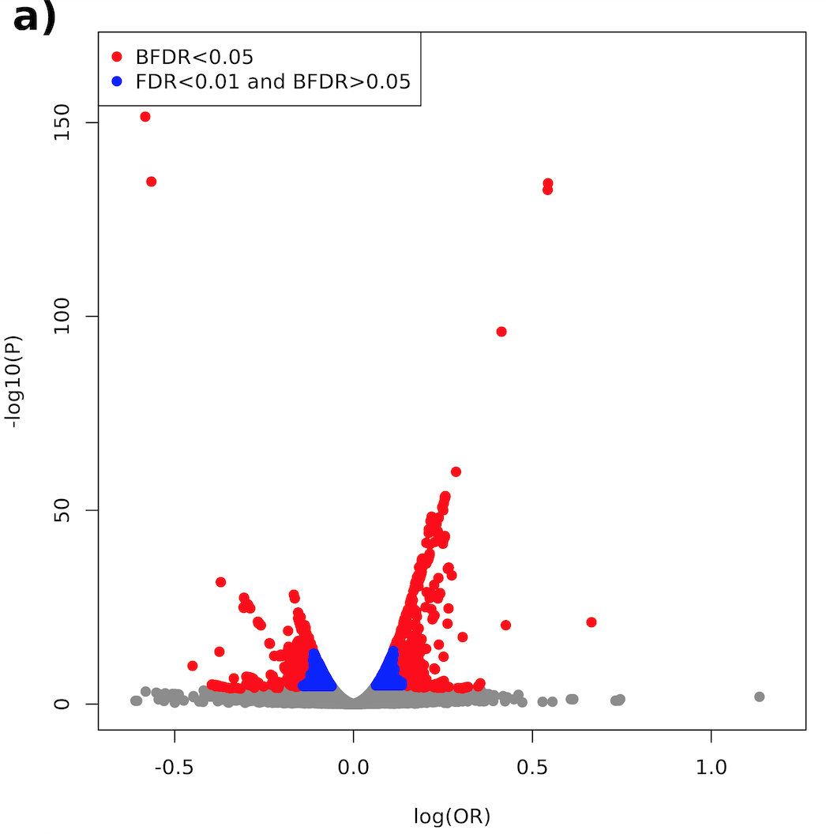
Empirical Bayes / FDR application in type 1 diabetes GWAS

Slide 40
Practical: False discovery rates (FDRs)
Estimate local and tail-area false discovery rates using our z-statistics
Can use the Benjamini-Hochberg method for the tail area rate. There is a function in R to do this (do a web search)
For local FDR, I give you permission to assume normality. Think about the chi-square version the previous slide

Slide 41
Part 5: Predict phenotype
Why?
Preventative medicine for at-risk patients
Lifestyle interventions
Livestock and crop selection
Find biological links between diseases
Once more, we’ll apply our ‘normal prior’ model.

Slide 42
Genomic best-unbiased linear predictor (BLUP)
Similar to before, the best predictor in a general sense is the posterior expectation
, where
g_{i} is often called the ‘breeding value’, ‘additive genetic value’ or ‘genetic value.
In our multivariate normal model, this is
…and we’ll plug in our parameter estimates accordingly, as with our posterior effect size estimates
Matrix inversion
de los Campos et al., 2013
Prediction of complex human traits using the genomic best linear unbiased predictor

Slide 43
Genomic best-unbiased linear predictor (BLUP)
Often when we want to predict, we have:
-Genotypes and phenotypes for a training set
-Only genotypes for a test set
Then, the expectation is:
de los Campos et al., 2013
Prediction of complex human traits using the genomic best linear unbiased predictor

Slide 44
Aside: polygenic scores (PGS)
Sometimes called polygenic risk scores (PRS)
Approach to fitting each SNPs coefficient explicitly – some similarities with machine learning
Fits model predicting phenotype from genotypes, using additional info from GWAS analysis, then applies to a test set to pick best tuning parameters

Slide 45
Practical: phenotype prediction
Try to predict phenotype from genotype using all our individuals, in the following ways:
Using G-BLUP
Using posterior effect sizes from yesterday
Using maximum likelihood (basic GWAS) estimates (you’ll have to be creative!)
Compare the estimates. Which do you think is best and why?

